Slide 1
Introduction to Bayesian Learning

Slide 2
Overview
Today we learn about:
Bayes rule & turn this into a classifier
E.g. How to decide if a patient is ill or healthy, based on
A probabilistic model of the observed data
Prior knowledge

Slide 3
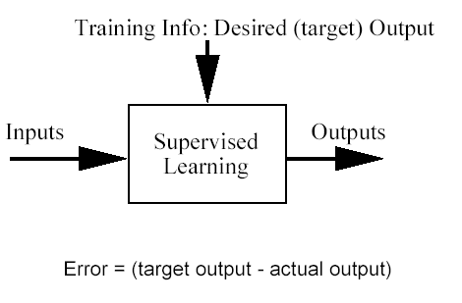
Classification problem
Training data: examples of the form (d,h(d))
where d are the data objects to classify (inputs)
and h(d) are the correct class info for d, h(d)∈{1,…K}
Goal: given d_{new}, provide h(d_{new})

Slide 4
Bayesian theorem

Slide 5
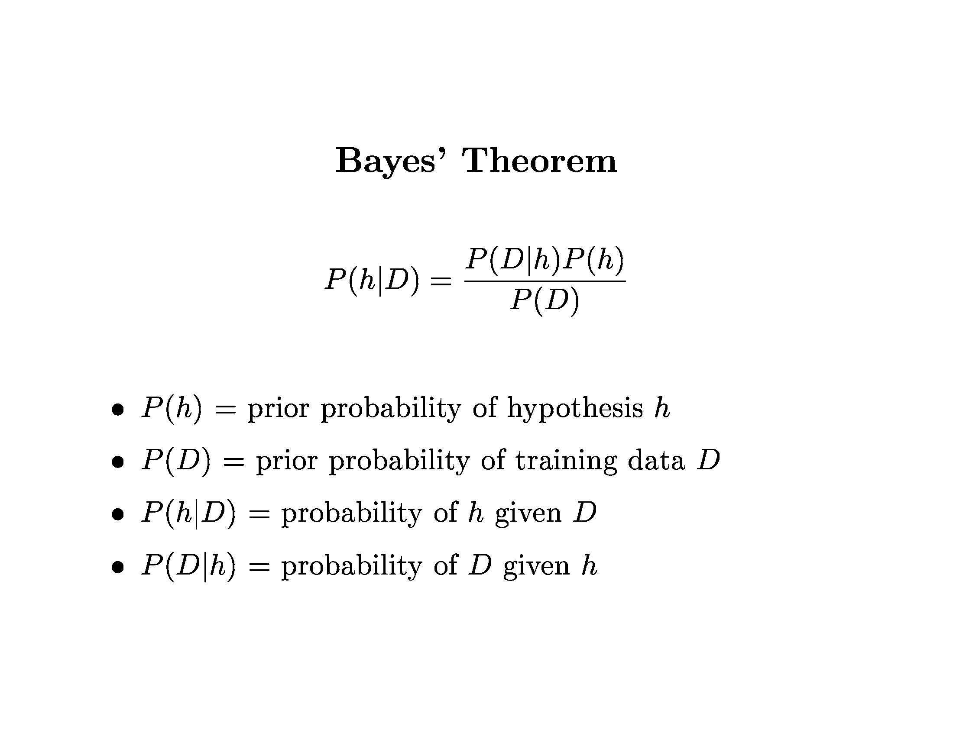

Slide 6
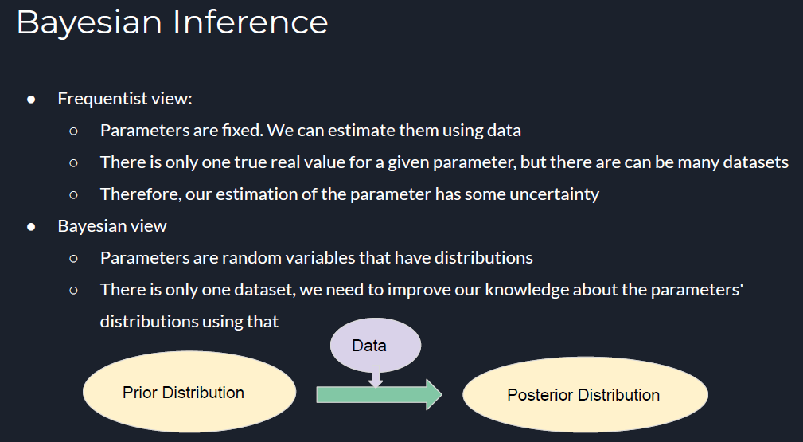

Slide 7
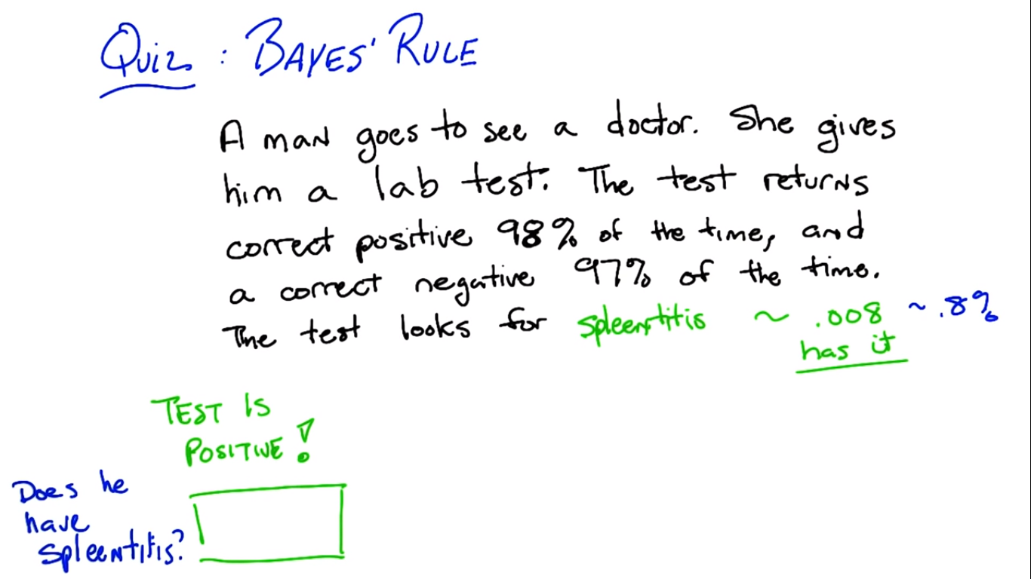
Bayesian rule - Example

Slide 8
A word about the Bayesian framework
Allows us to combine observed data and prior knowledge
Provides practical learning algorithms
It is a generative (model based) approach, which offers a useful conceptual framework
This means that any kind of objects (e.g. time series, trees, etc.) can be classified, based on a probabilistic model specification

Slide 9
Bayesian learning

Slide 10
Generative vs Discriminative
Generative – Model based, Probabilistic
Discriminative – Focuses on finding a decision boundary
Bayesian learning is a generative model

Slide 11
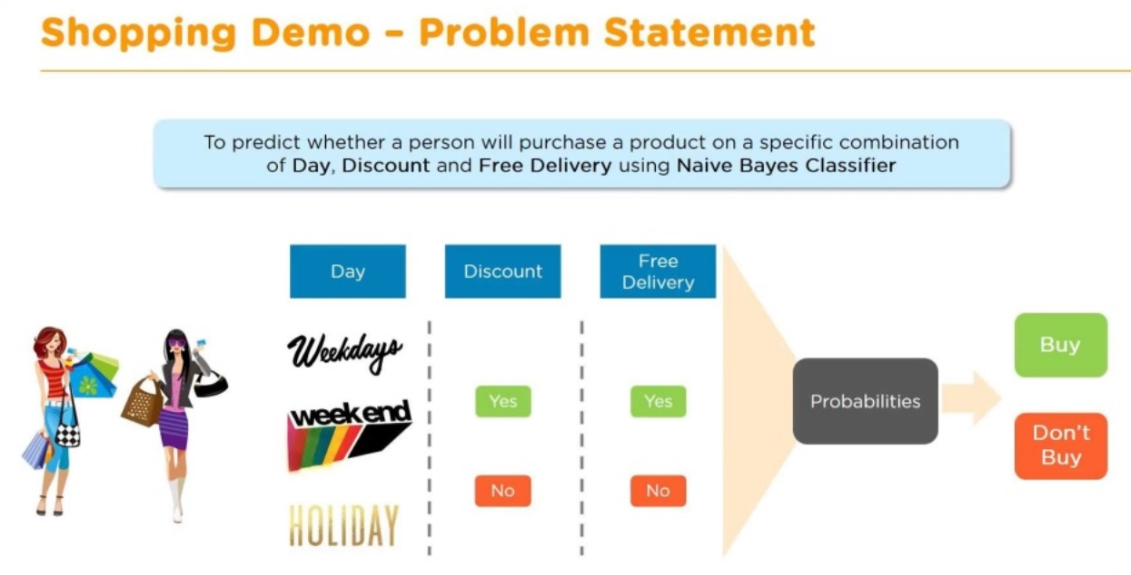

Slide 12
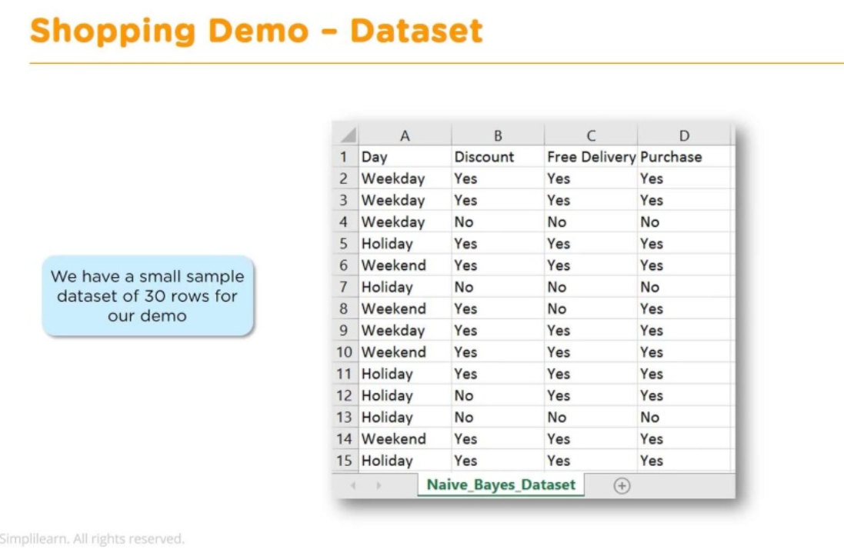

Slide 13
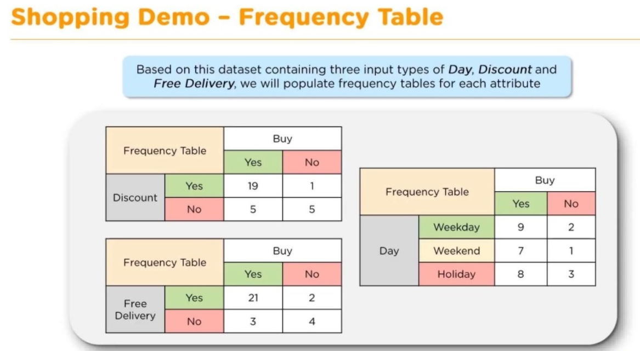

Slide 14
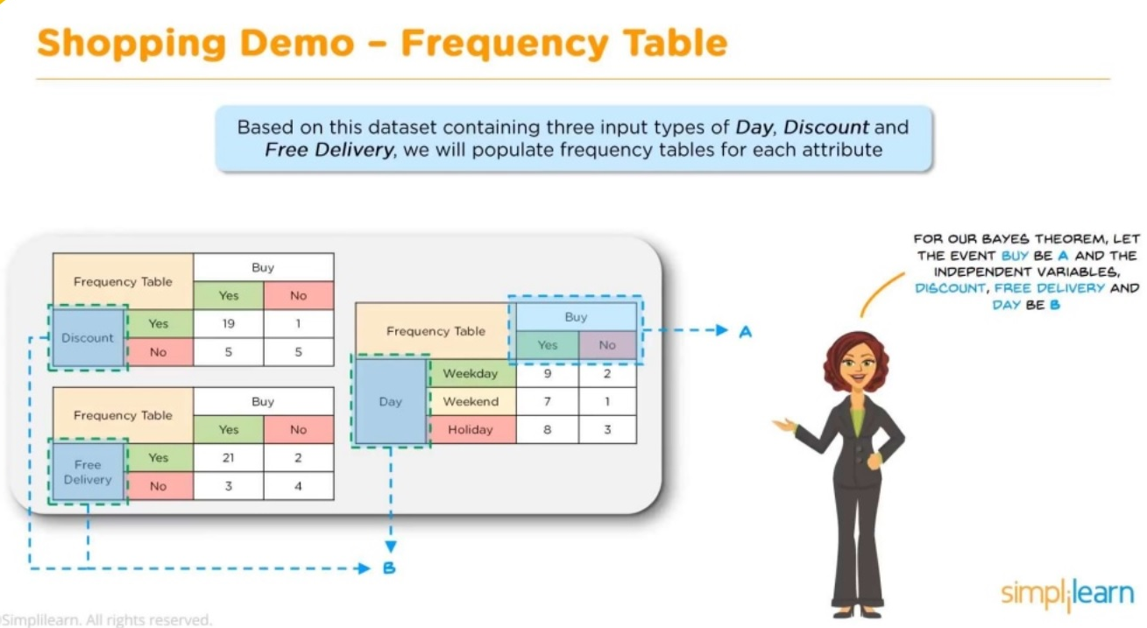

Slide 15
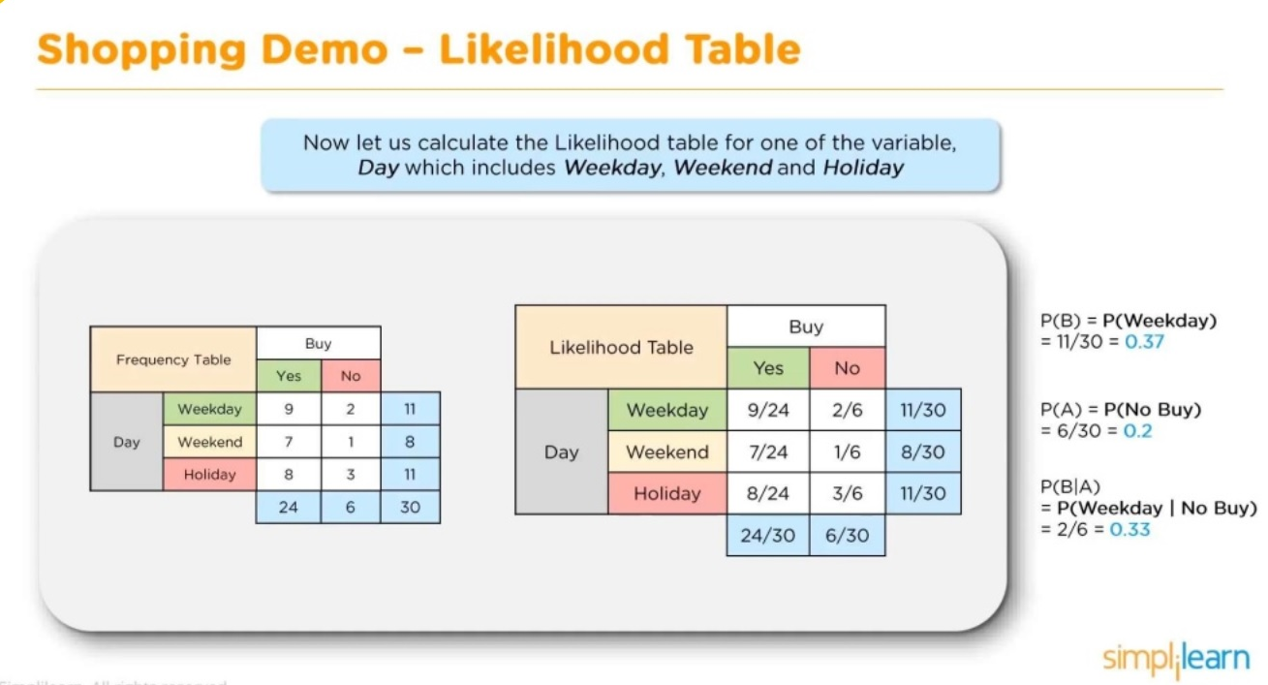

Slide 16
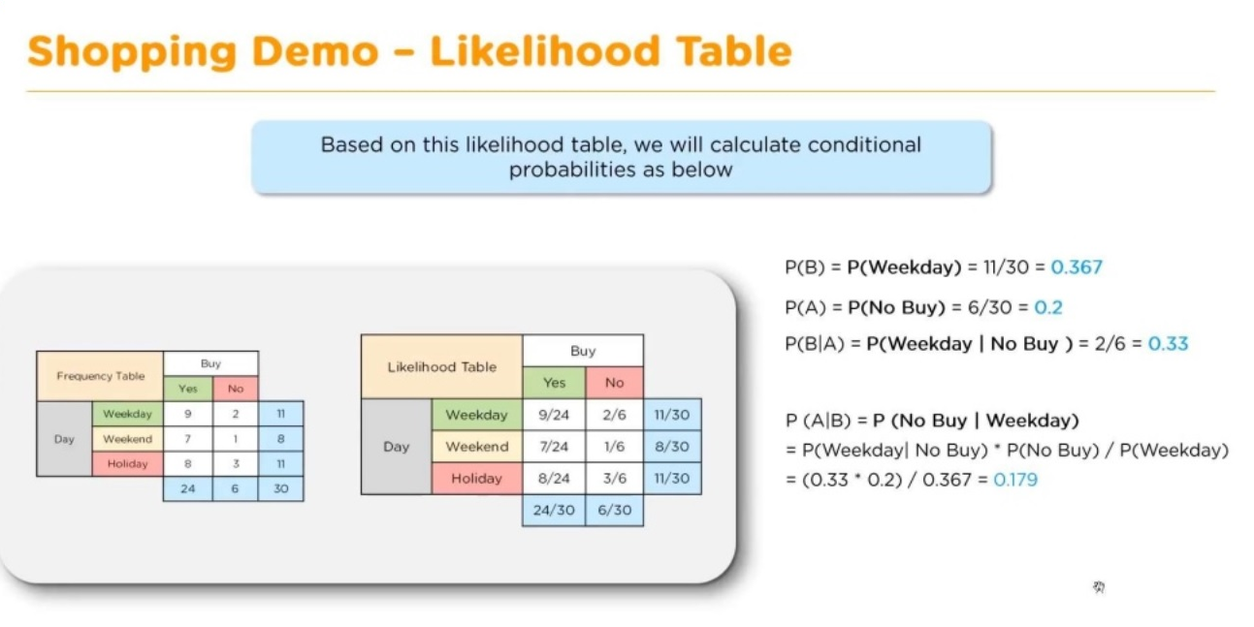

Slide 17
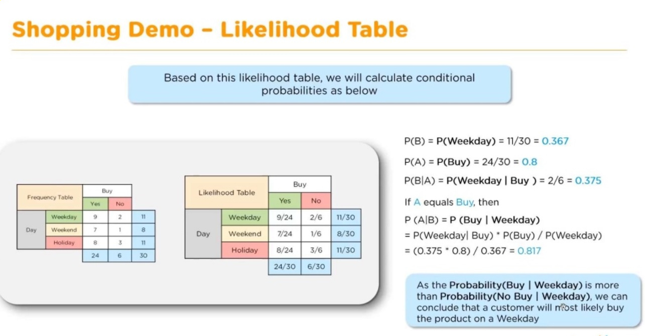

Slide 18
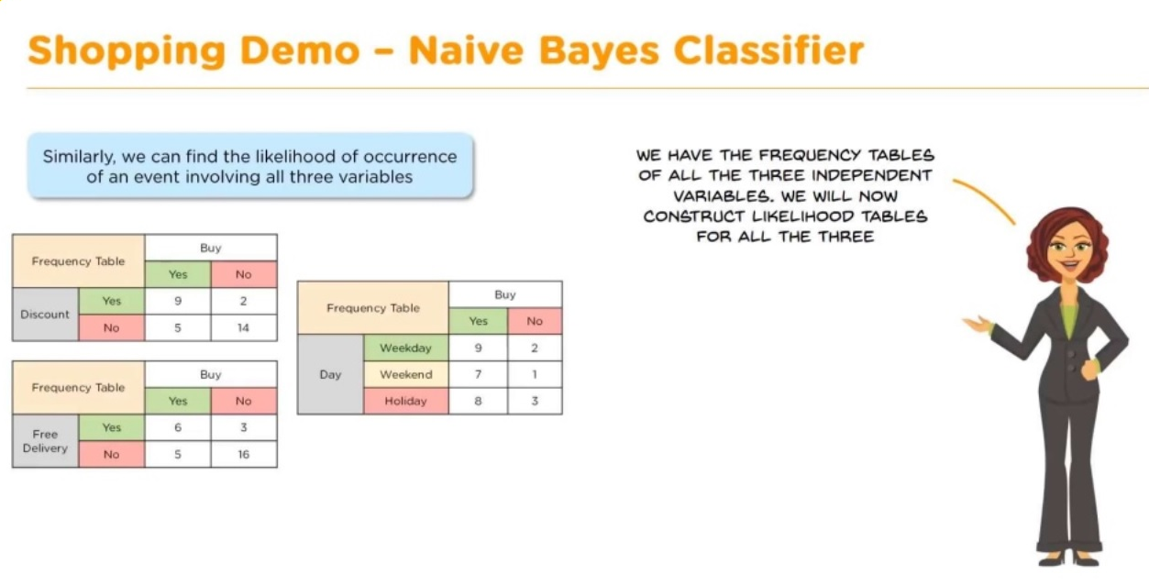

Slide 19
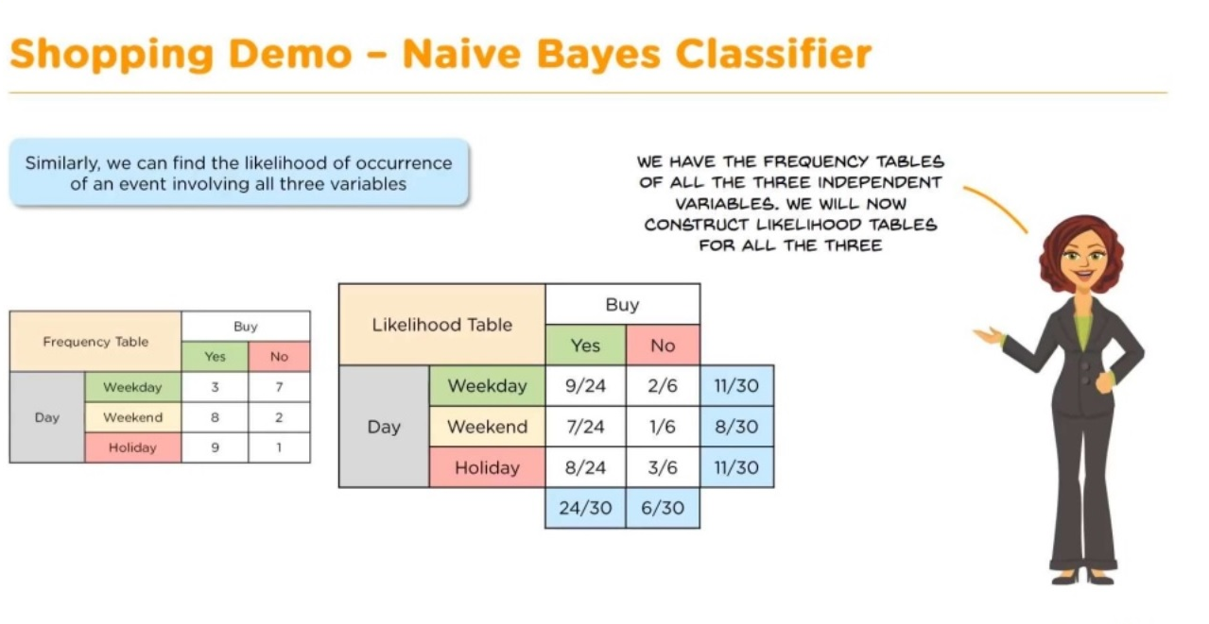

Slide 20
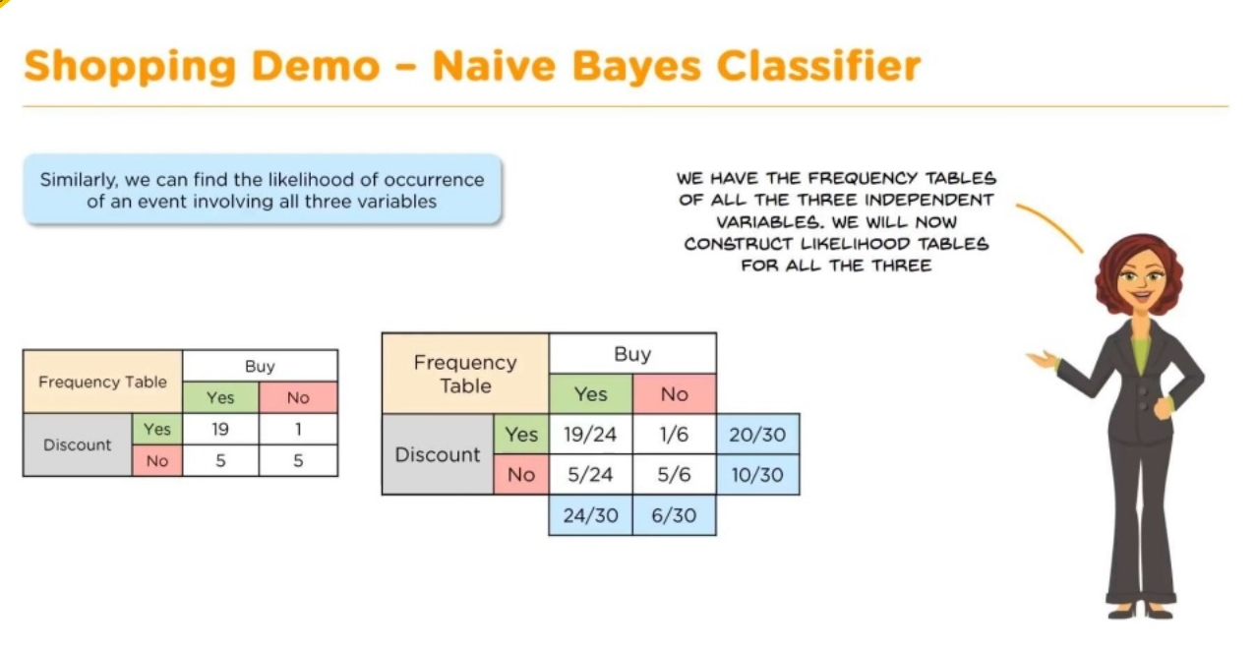

Slide 21


Slide 22
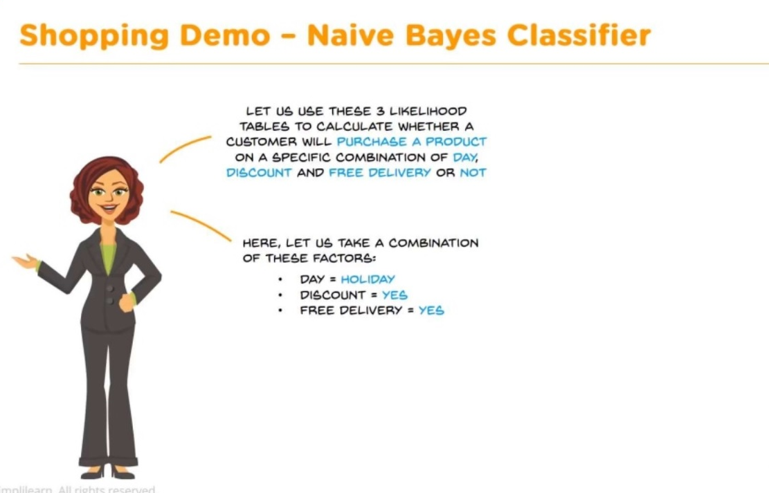

Slide 23
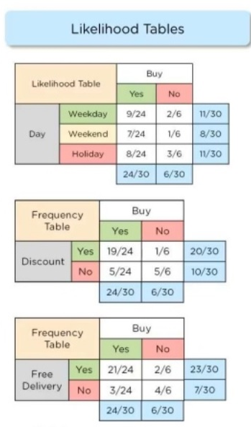
Naïve Bayeian – To Do

Slide 24
Bernoulli Naive Bayes : It assumes that all our features are binary such that they take only two values. Means 0s can represent “word does not occur in the document” and 1s as "word occurs in the document".
Multinomial Naive Bayes : Its is used when we have discrete data (e.g. movie ratings ranging 1 and 5 as each rating will have certain frequency to represent). In text learning we have the count of each word to predict the class or label.
Gaussian Naive Bayes : Because of the assumption of the normal distribution, Gaussian Naive Bayes is used in cases when all our features are continuous.

Slide 25
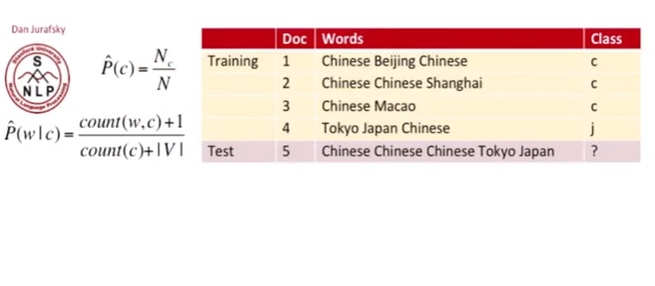
Multinomial naïve bayesian learning – text classification example

Slide 26
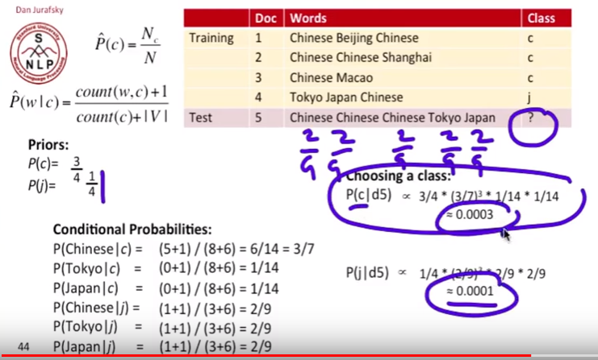

Slide 27
Bayesian Networks
Naïve Bayes assumption of conditional independence too restrictive
But it is intractable without some such assumptions
Bayesian Belief network (Bayesian net) describe conditional independence among subsets of variables (attributes): combining prior knowledge about dependencies among variables with observed training data.
Bayesian Net
Node = variables
Arc = dependency
DAG, with direction on arc representing causality

Slide 28
Bayesian Networks
Age, Occupation and Income determine if customer will buy this product.
Given that customer buys product, whether there is interest in insurance is now independent of Age, Occupation, Income.
P(Age, Occ, Inc, Buy, Ins ) = P(Age)P(Occ)P(Inc)
P(Buy|Age,Occ,Inc)P(Int|Buy)
Current State-of-the Art: Given structure and probabilities, existing algorithms can handle inference with categorical values and limited representation of numerical values
Occ
Age
Income
Buy X
Interested in
Insurance

Slide 29
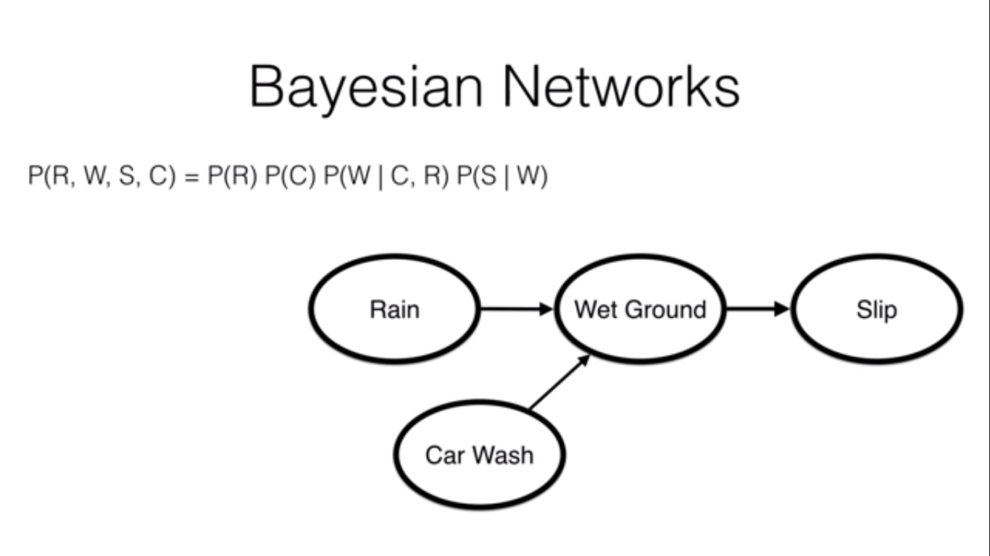

Slide 30
Hidden Markov Model
Uses ‘makov states’ connected in a state diagram
Applies bayesian theorem
Hidden states/Observations
Transition probabilities/emission probabilities
Useful when the problem involves a time sequence of states

Slide 31
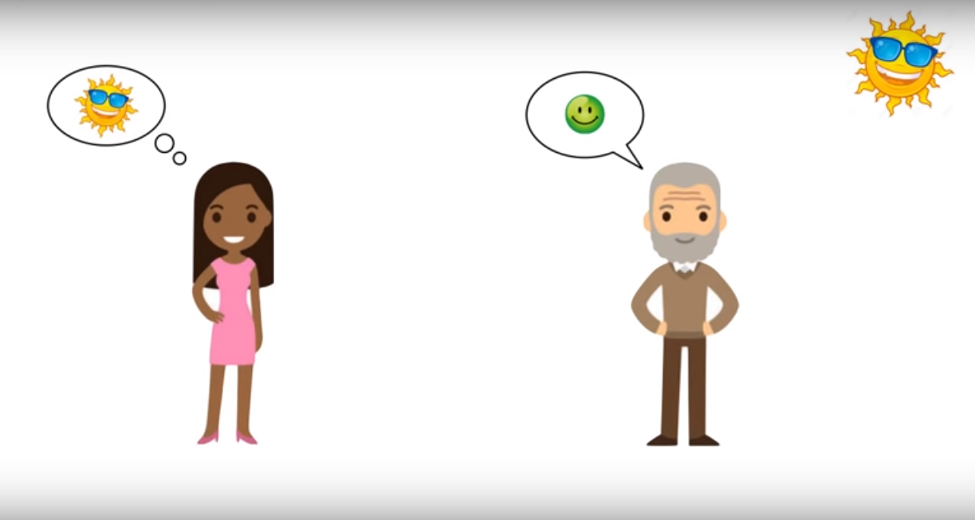

Slide 32
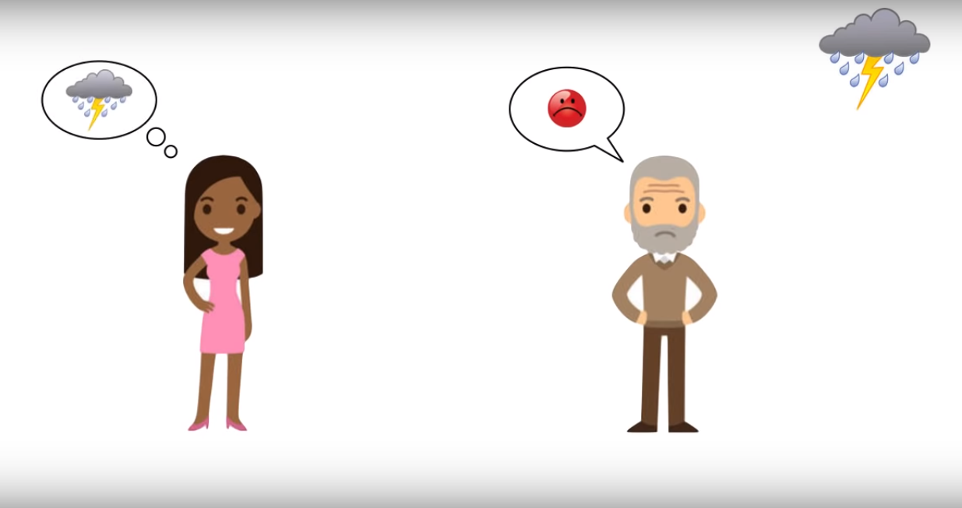

Slide 33
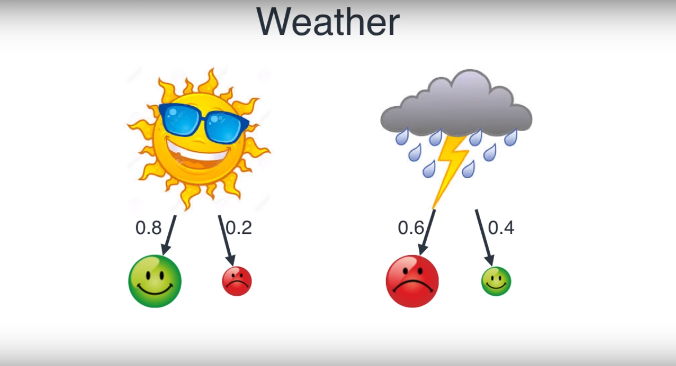

Slide 34
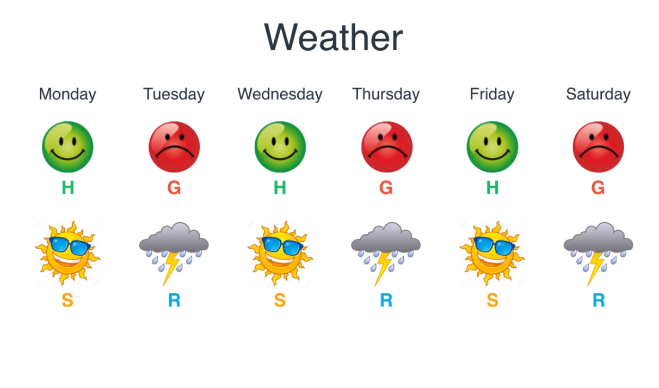

Slide 35
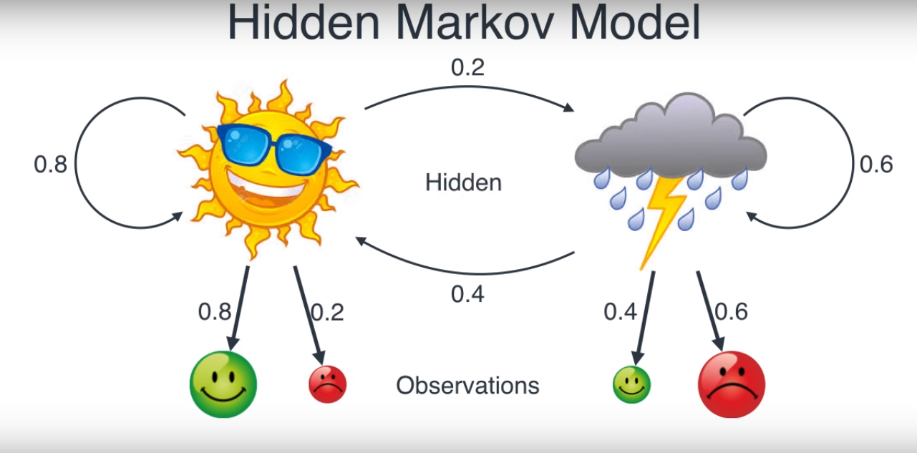

Slide 36
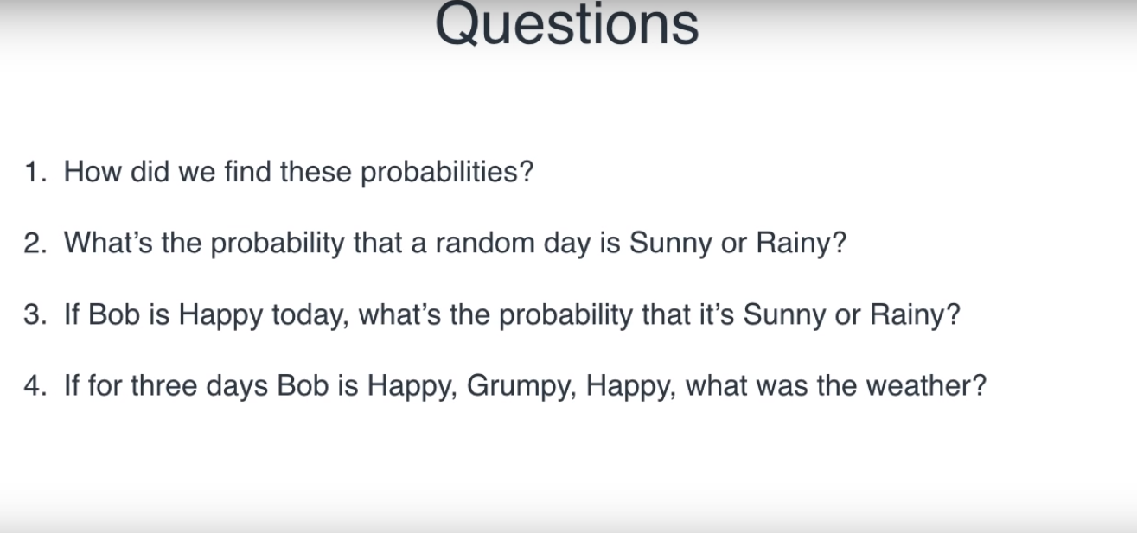

Slide 37
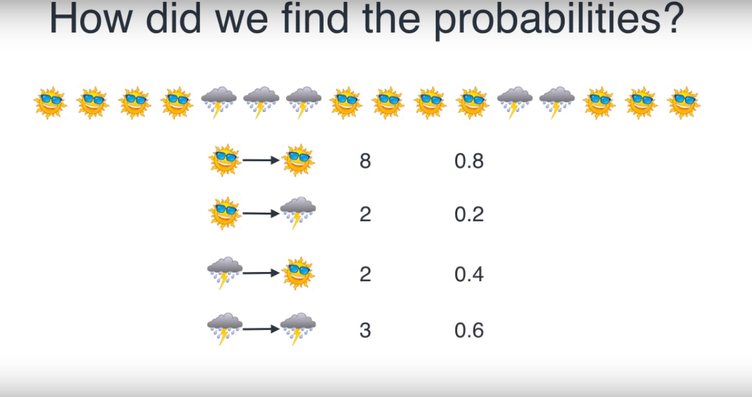

Slide 38
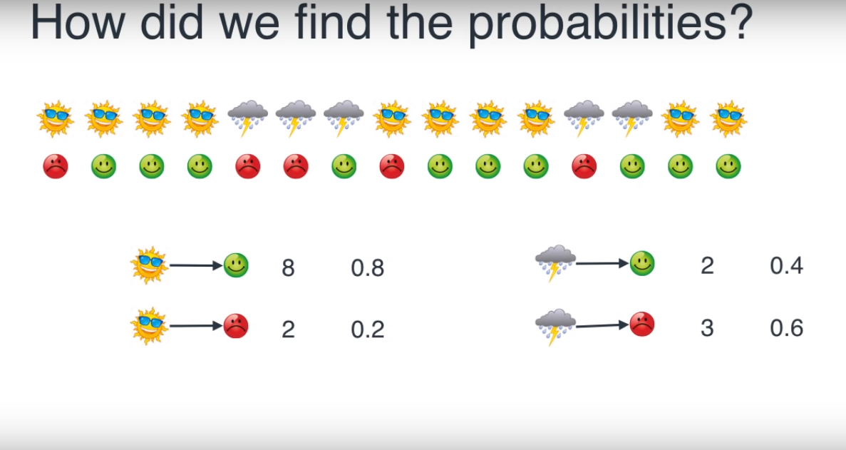

Slide 39
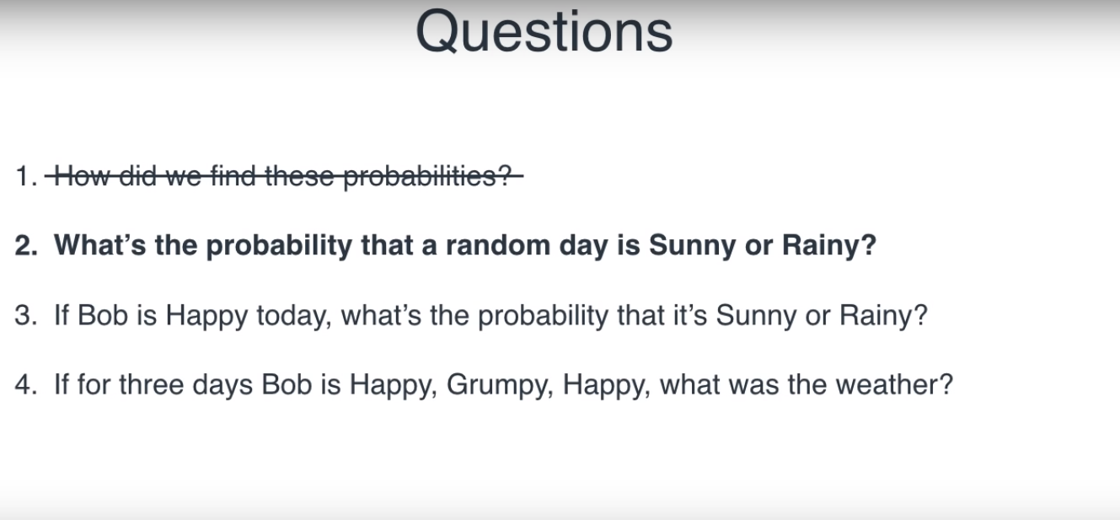

Slide 40
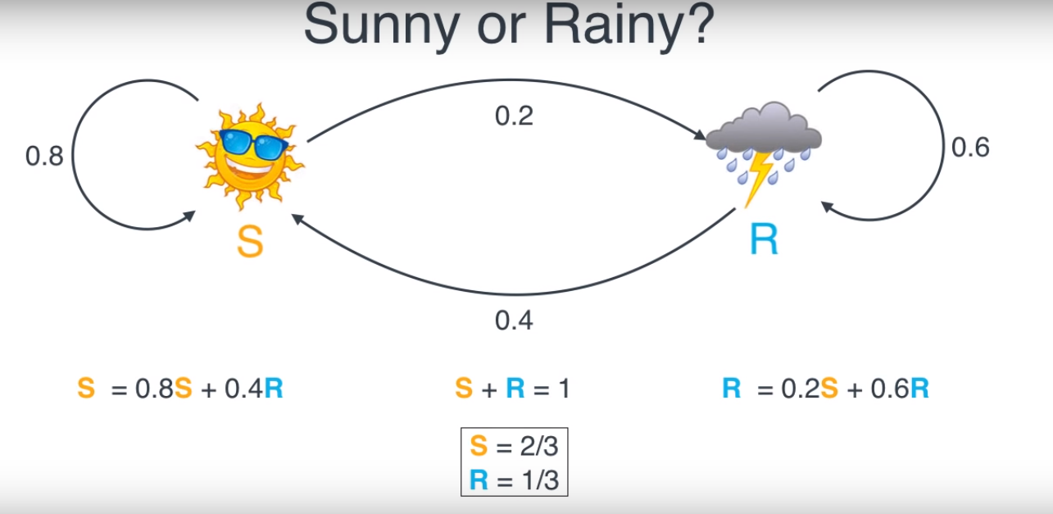

Slide 41
To do : third question

Slide 42
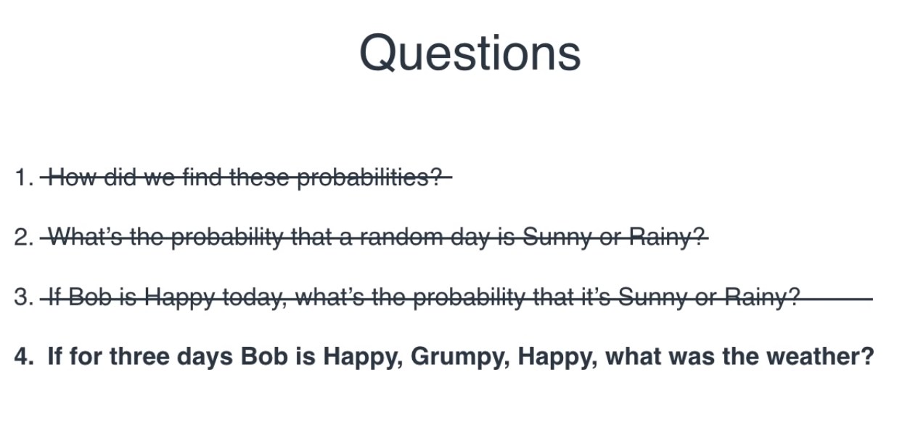

Slide 43
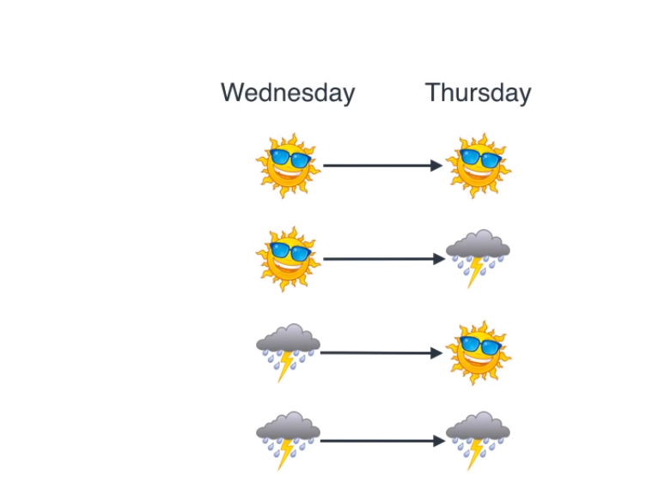

Slide 44
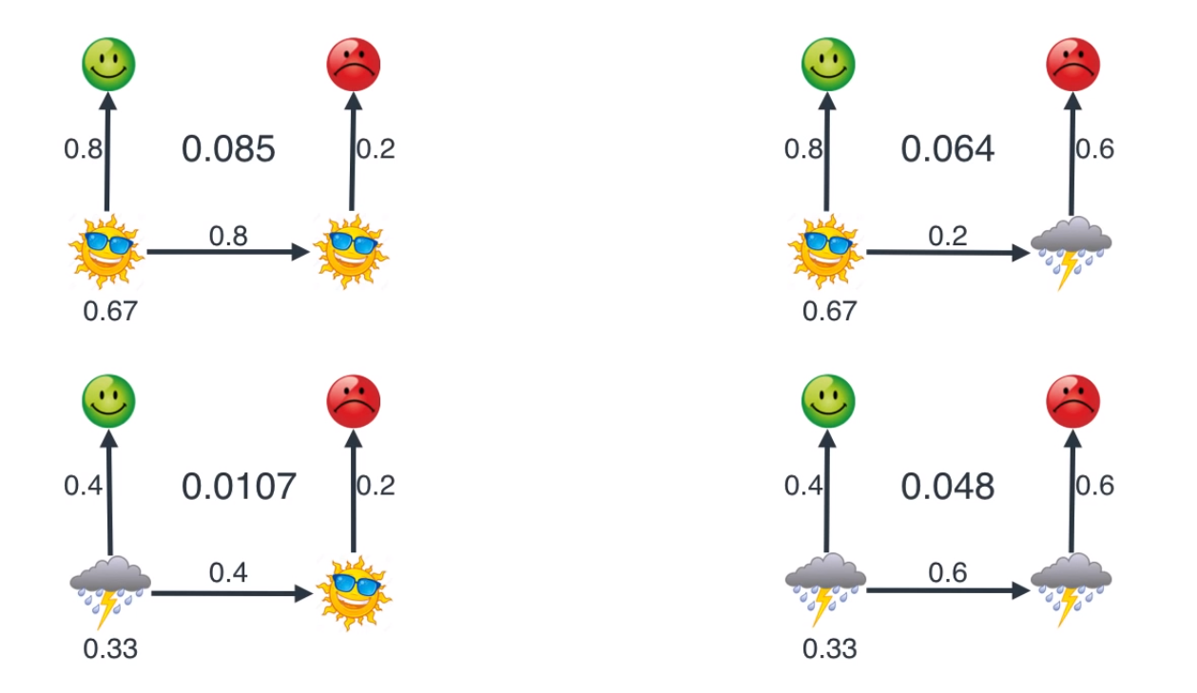

Slide 45
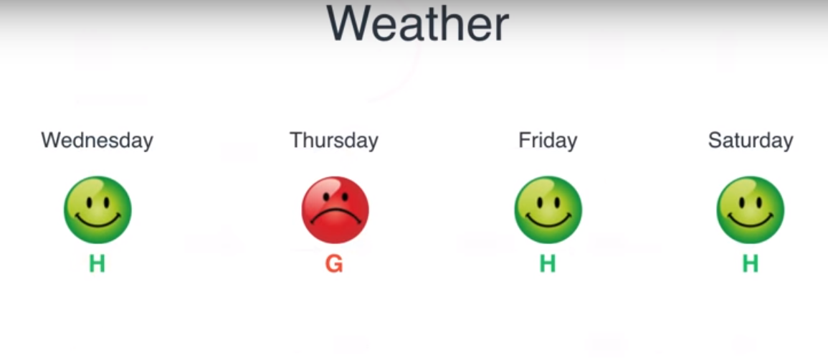

Slide 46
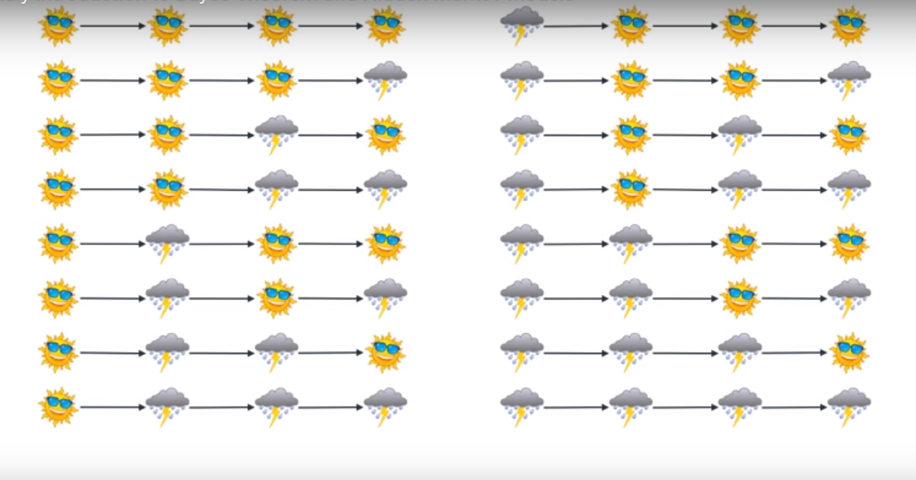

Slide 47
Viterbi algorithm

Slide 48
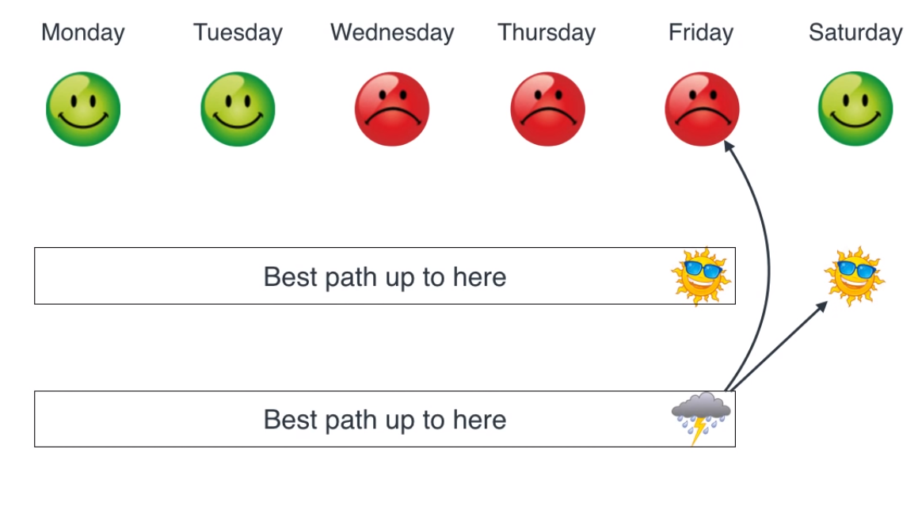
Viterbi algorithm

Slide 49
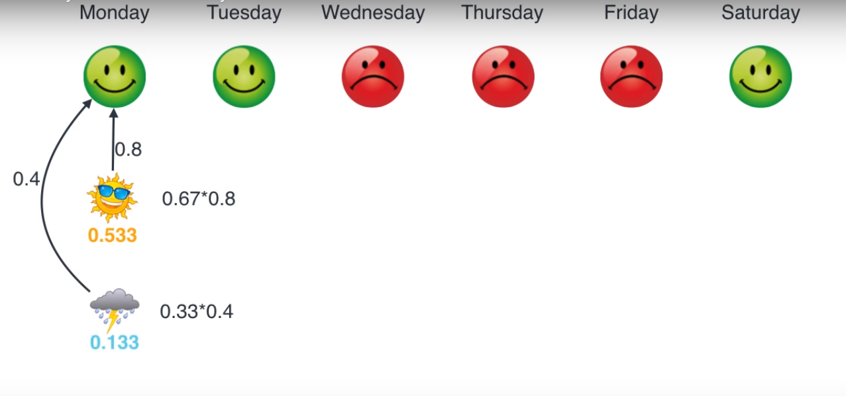

Slide 50
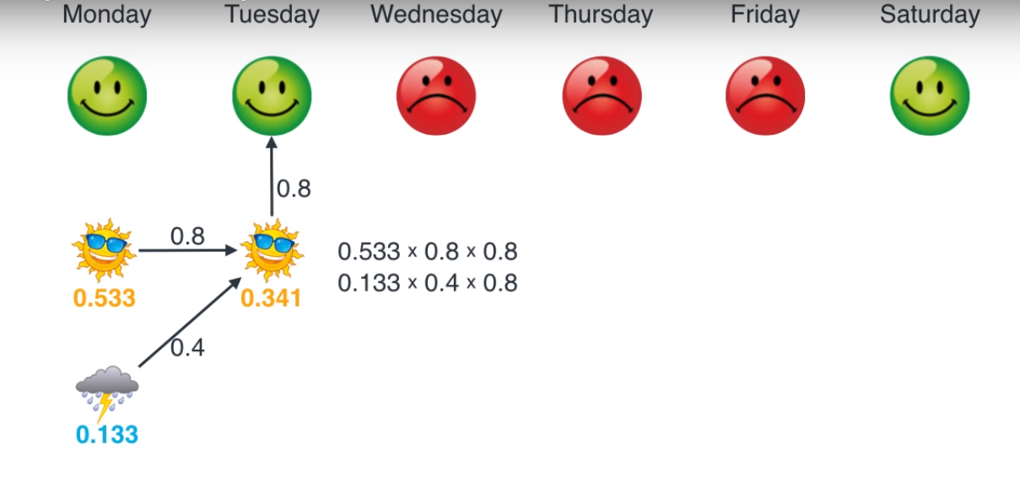

Slide 51
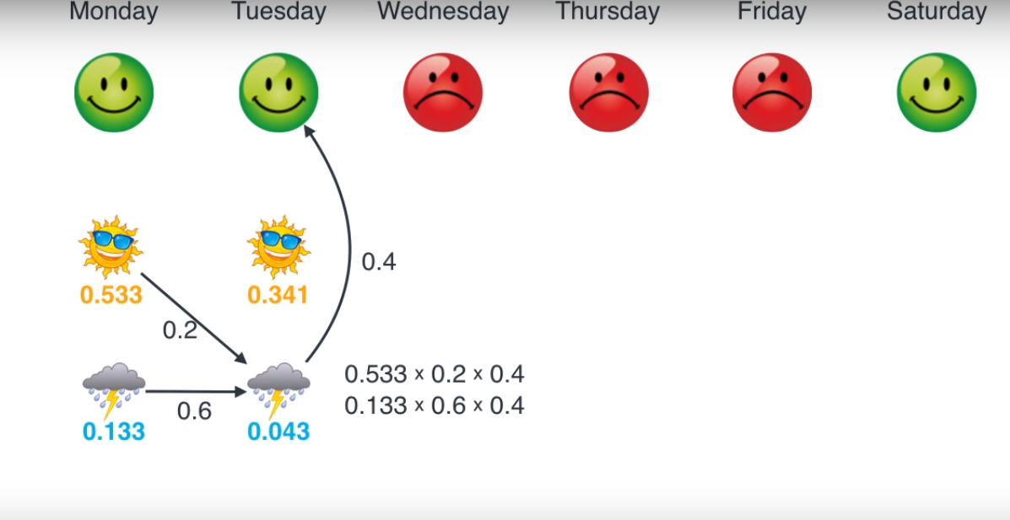

Slide 52
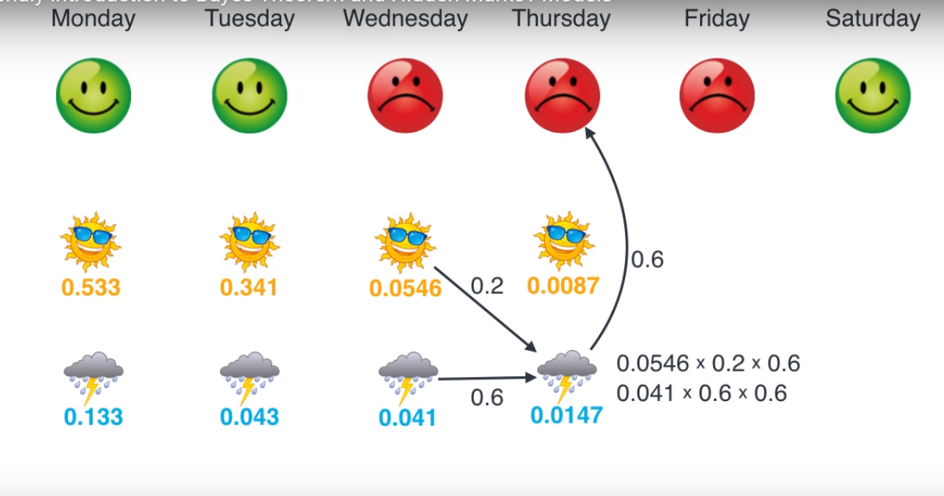

Slide 53
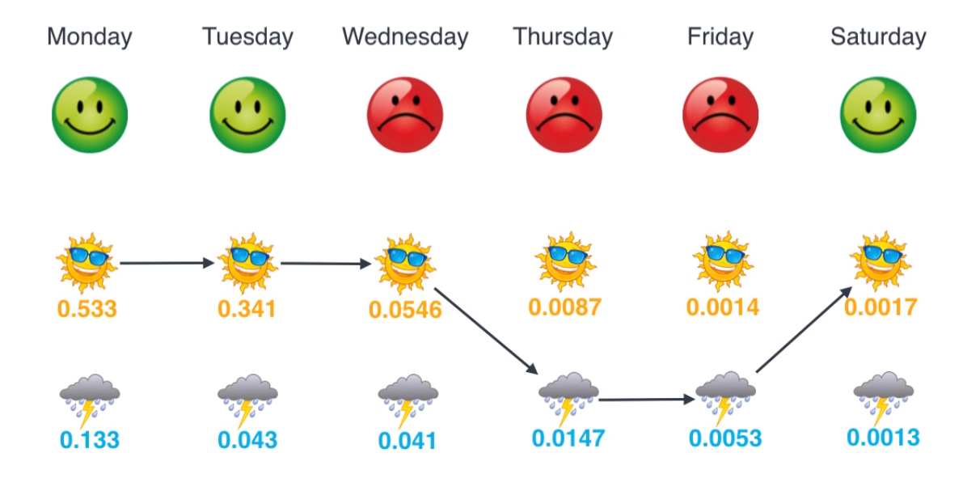

Slide 54
When transition probabilities are not known
Baum-Welch algorithm

Slide 55
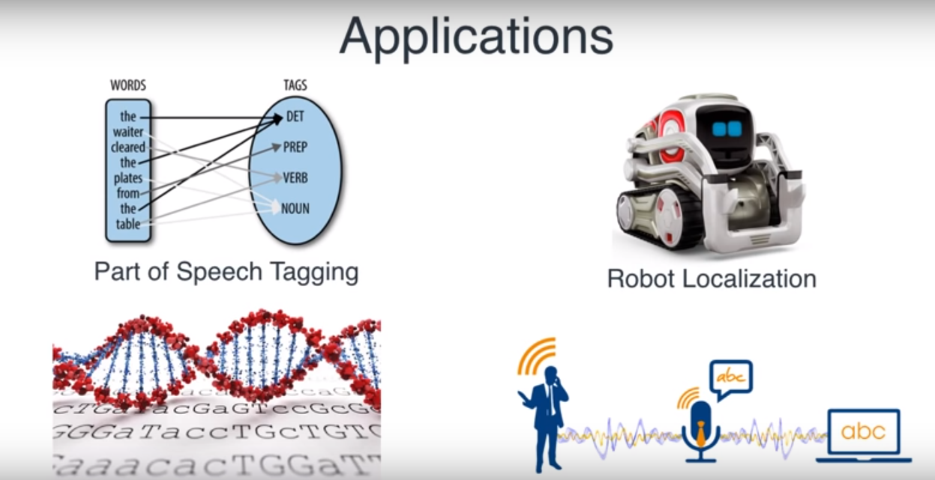

Slide 56
Summary
Bayesian learning is a generative learning model (as opposed to discriminative learning)
Naïve Bayesian (Gaussian, Multinomial, etc)
Hidden markov models for modelling a sequence of stochastic events

